Slide 1
< Cascade >
Contactless Cafeteria Ordering System
Deepti Ravi Kumar
19Z210
BE-CSE (G1)

Slide 2
Pre-covid
Post-covid

Slide 3
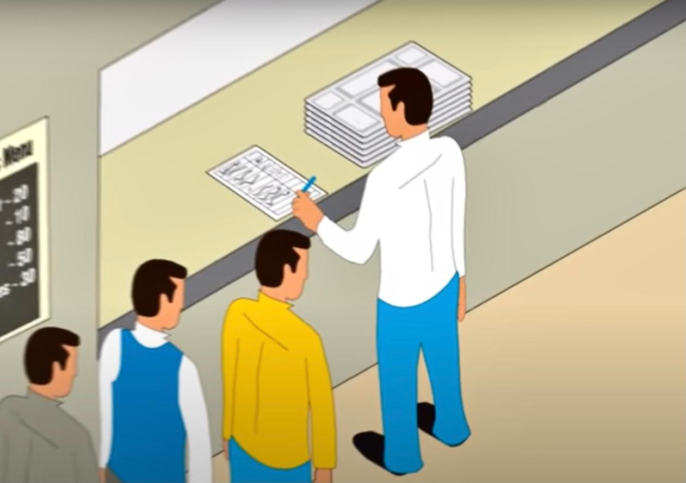
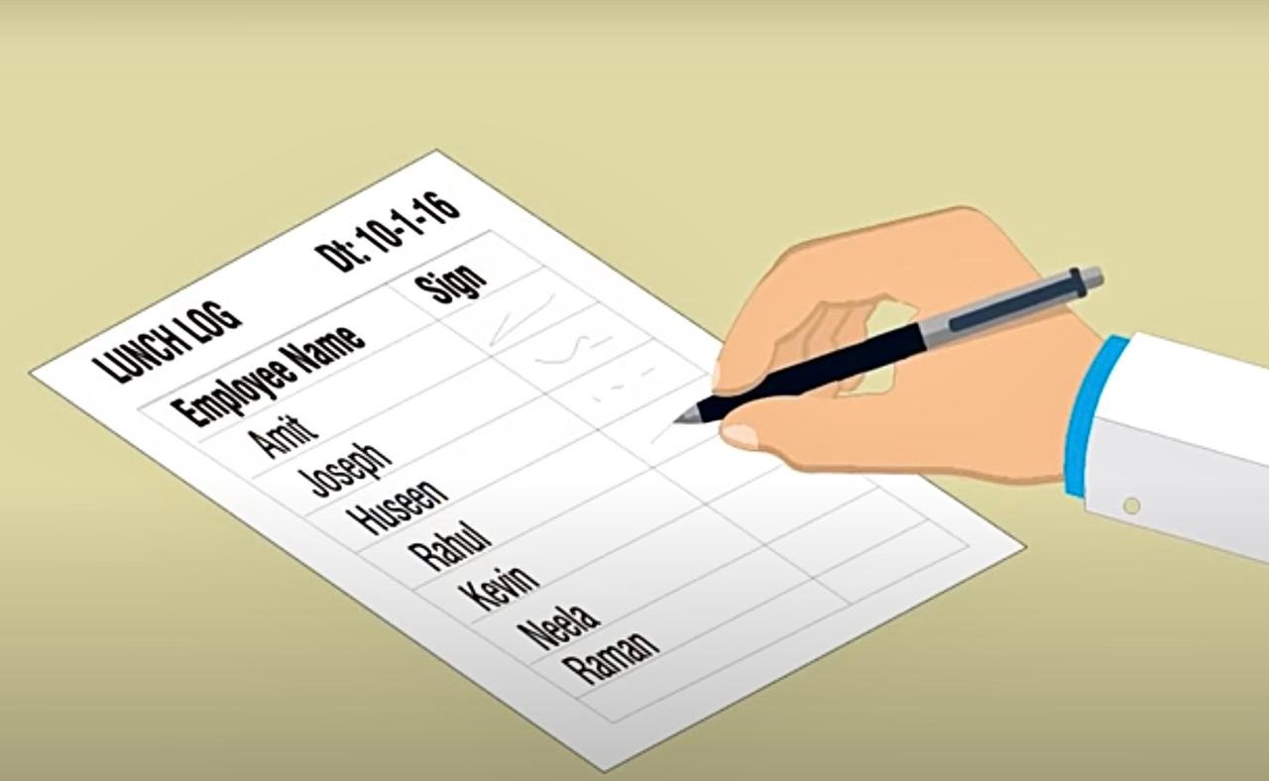
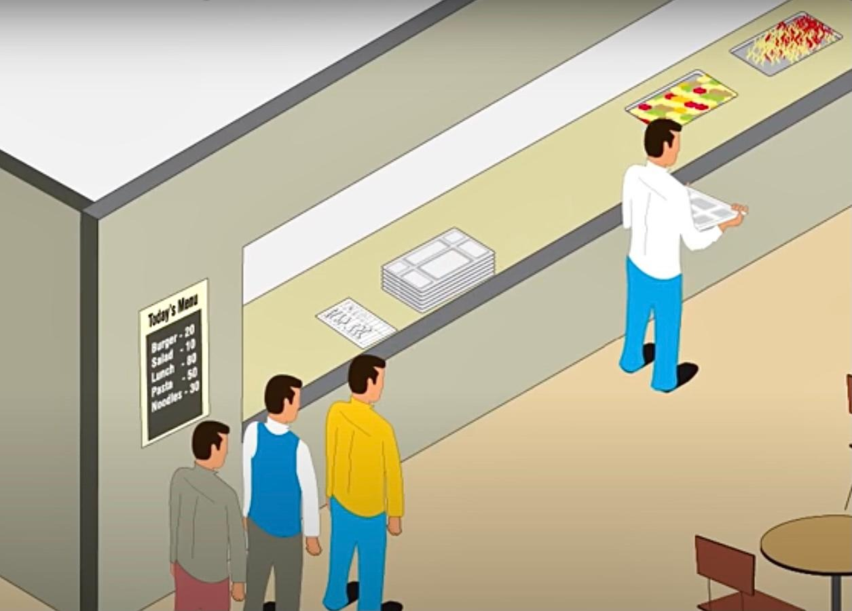
Traditional paper-coupon system of cafeteria

Slide 4

Drawbacks
Difficult to control food wastage
Problem in billing
Difficulty in cost computing
Issue in controlling crowd

Slide 5
Proposed solution
The Cascade - Cafeteria Ordering System assists the canteen manager in managing the canteen more efficiently and effectively by automating meal ordering, billing, and inventory control. The AI-based attendance and food collection tracking can help to ensure effective food distribution, as well as penalty and refund decisions.

Slide 6
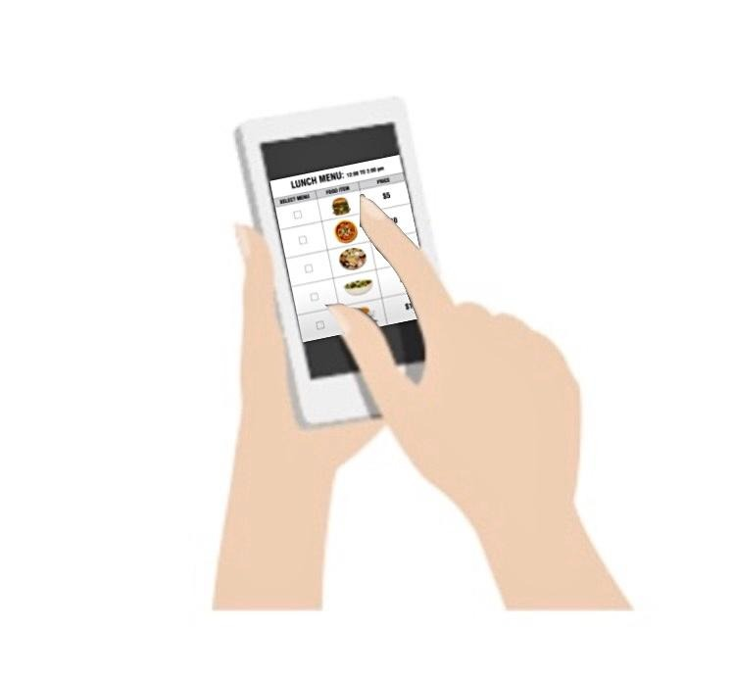

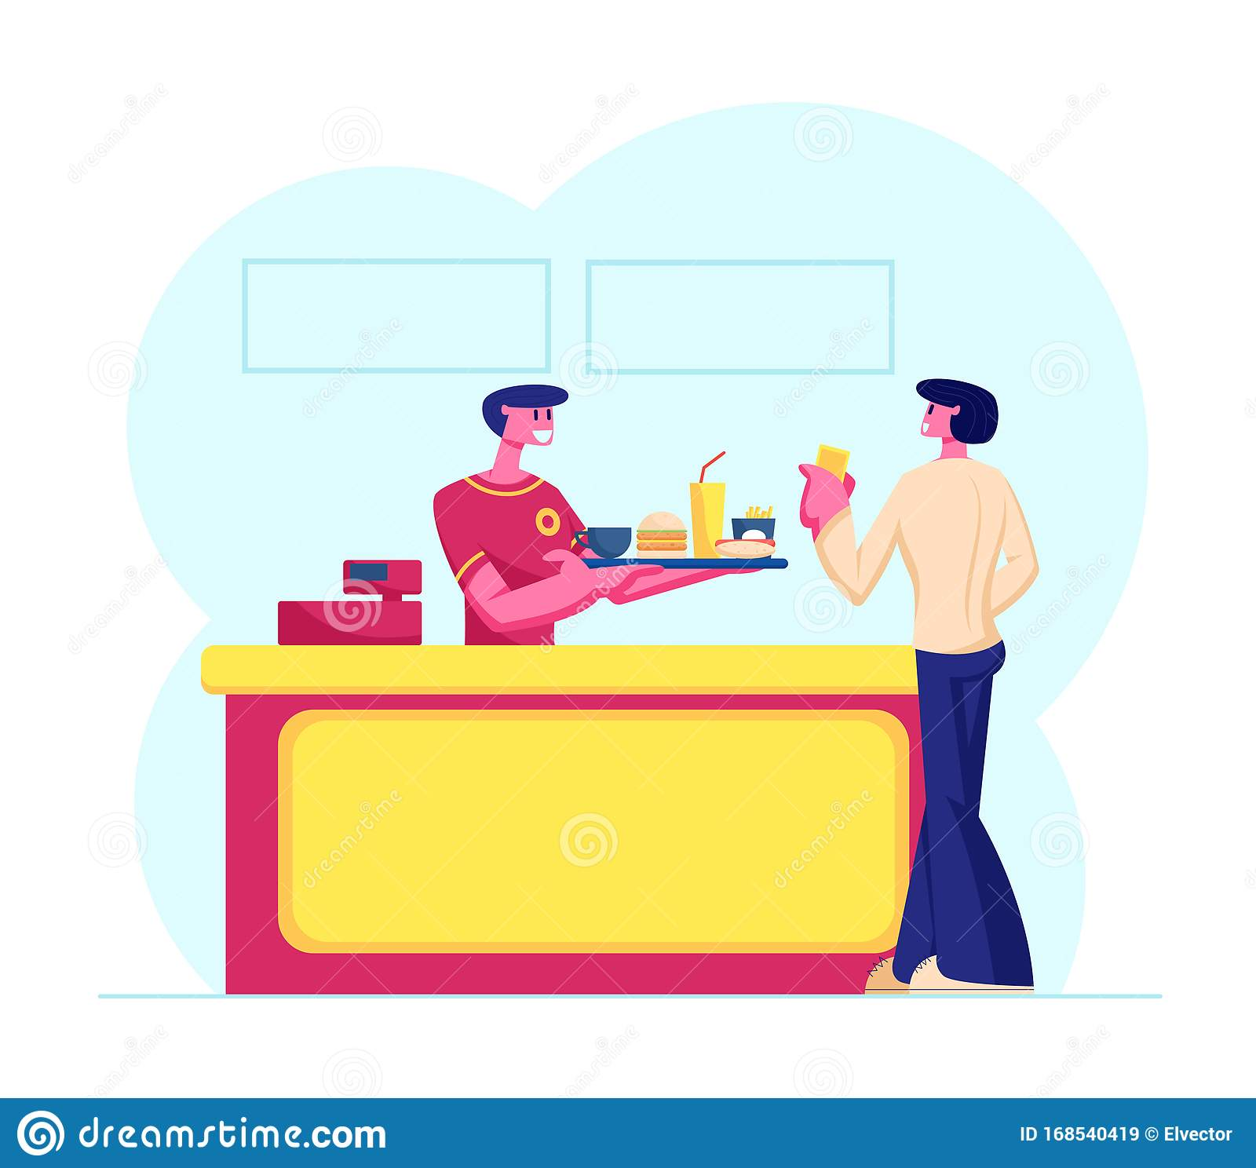
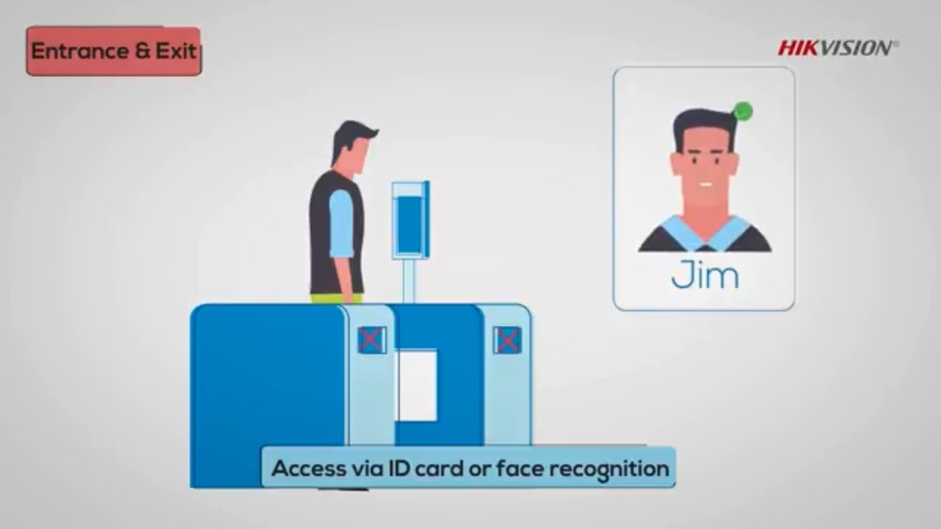
Place order
Food preparation
Get notification
Give feedback
Collect order
Attendance using face recognition

Slide 7
Merits
Rapid food ordering: the ordering of items would be done in a minimum time duration without any delays.
Acquiring orders in minimum time: orders need to be considered in minimum time without any delays.
Less use of paper: Manual work would be reduced.
Ordering and billing are computerized: Ordering and billing would be computerized, activities like ordering are performed through a web page.

Slide 8
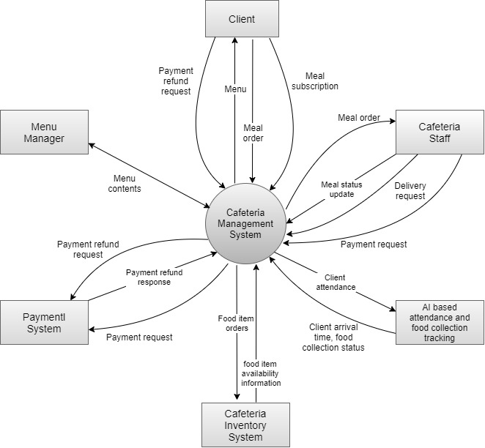
Product functions All the functions will be performed in the order given below, ●Food order via application ●Confirm order ●Online Payment ●Serve food ●Available goods ●Required goods ●Customer information ●Customer review

Slide 9
3 Phases of the product
Staff
Admin
User
Preparation of order and food delivery
Updating Inventories
Count of sales placed in week and month
Count of each individual item sold every day
Count of Total earnings
Selection of items from Menu
Placing of orders
Billing

Slide 10
System Requirements
Admin Login
Can add, update or delete:
Admin data
Food categories data
Food items data
Order data
Can view :
Dashboard with revenue details, total orders, food categories and food items
Customer delay

Slide 11
System Requirements
Customer page
View featured food items and categories
Surf through various food items
Choose food based on categories
Place food order
Review the invoice for order status
Face attendance for food collection
Penalty based on delay time
Give feedback

Slide 12
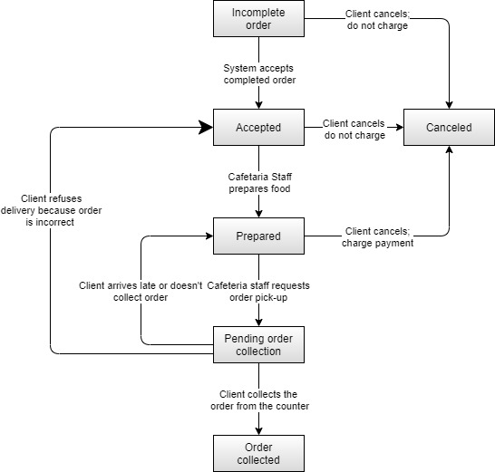
State transition diagram
The system analyses transactions and saves the generated data, which the manager may use to produce reports and make informed business choices for the canteen.

Slide 13
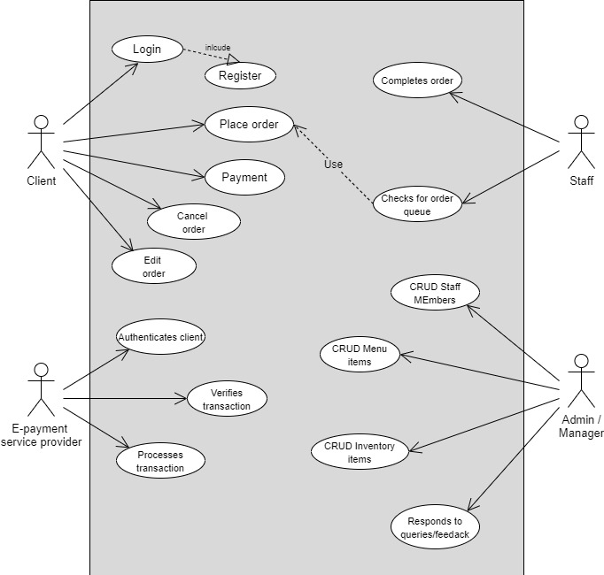
Use case diagram

Slide 14
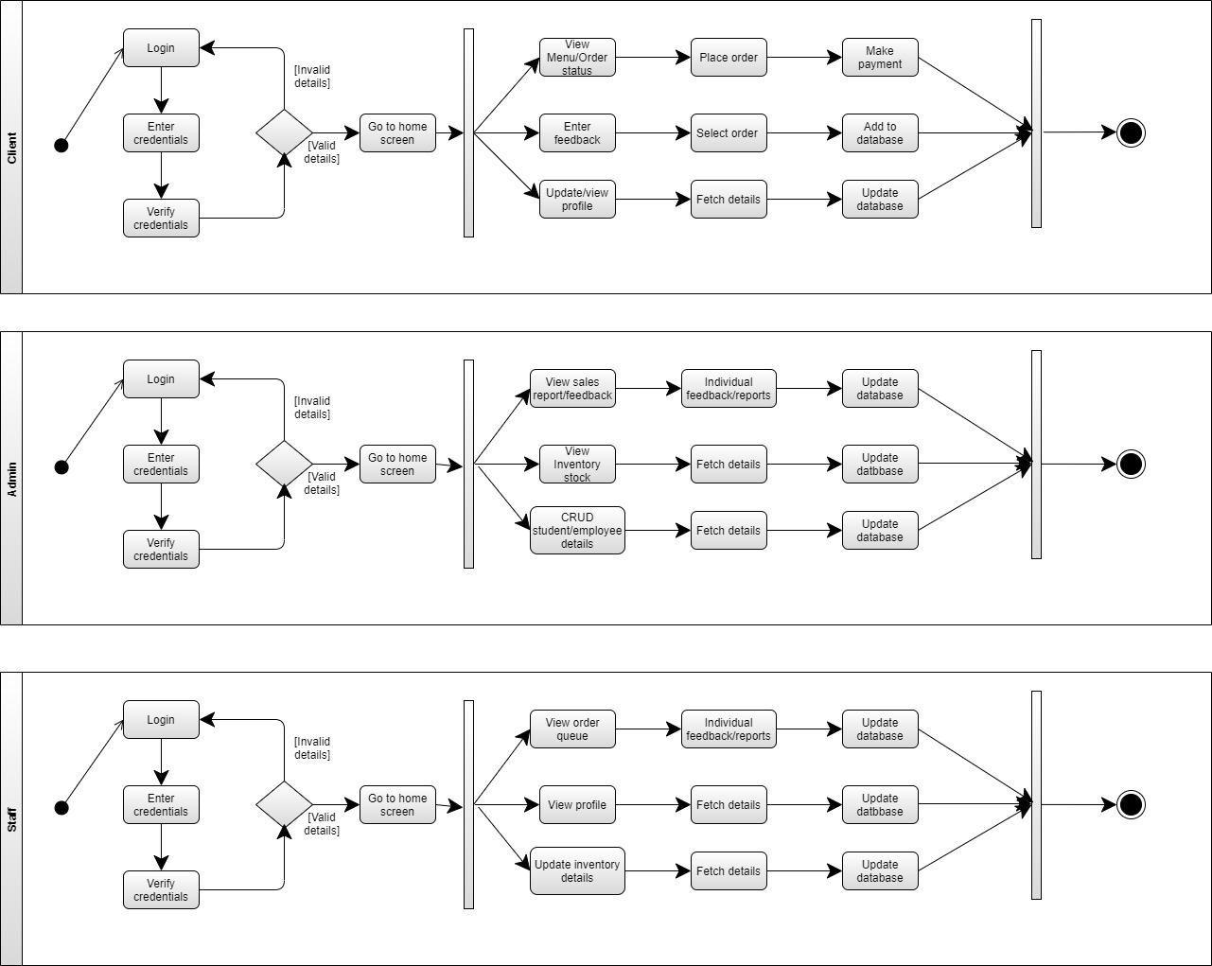
Activity Diagram
The purpose of this project is to build an application and reduce manual work for managing activities. It tracks the details about orders, student details, and staff.

Slide 15
Functional Requirements
The system will show a list of cards (UI element) of dishes. Each card will have a picture of the dish. Next to the dish it shows the price in Rupees per serving.
The system will show all available dishes to the Customer.
Tapping on any of the displayed dish will result in a popup for quantity.
The popup for quantity input will not allow the user to enter letters, negative numbers, or any invalid characters.
After completing the order, the system will display the order status “Time to complete the order” and it is the total time required to serve the dish keeping in view the previously queued orders.
The face recognition-based attendance system will help take penalty or refund decisions based on a fixed time delay between the customer attendance and the time when order placed.

Slide 16
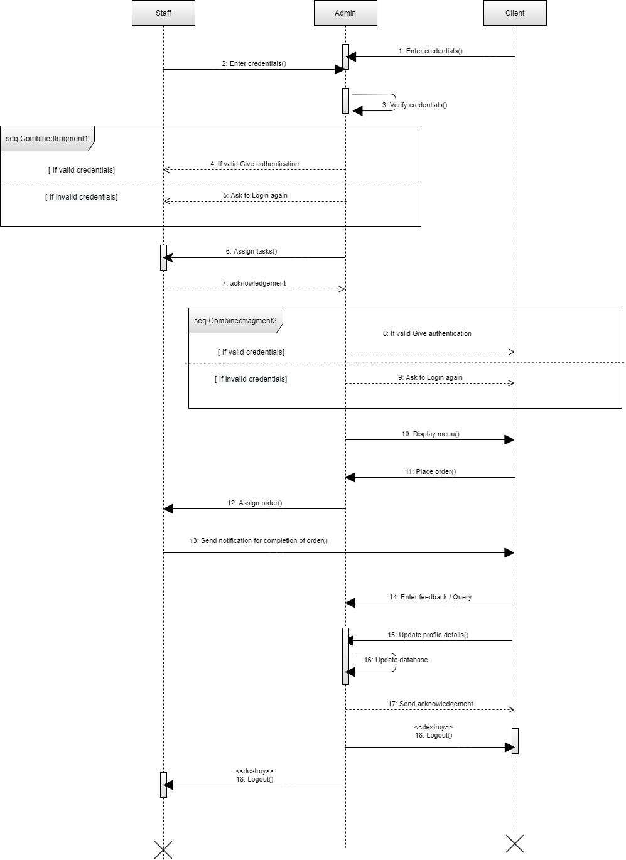
Sequence diagram

Slide 17
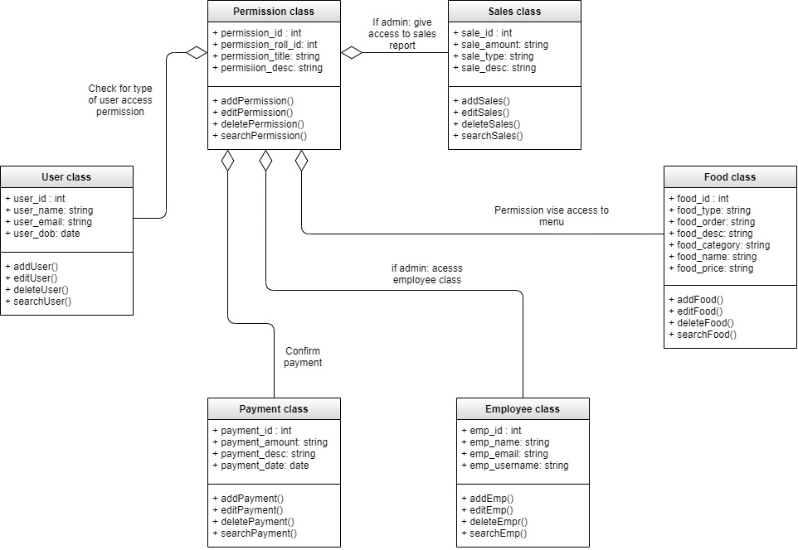
Class Diagrams

Slide 18
Operating Environment
Hardware environment
Hardware requirements include Jetson Nano or Raspberry Pi and Pi-camera for the ML-based attendance system and order collection tracking.
Software environment
The application will utilize HTML, CSS and PHP for frontend and Python and MySQL for backend

Slide 19
Future work
Conclusion
The aim of this project is to ease out the food ordering process at a canteen / cafeteria.
All the order details like the order types would be stored daily which reduces manual work.
Use of Real-time database makes it one of a kind as all the data will be saved in the database and administrator can view all the data on time.
Add different payment options such as Paytm, PayPal, UPI etc. Enhance user interface by adding more user interactive features. Allow to process order as a guest.

Slide 20
Project Demo

Slide 21
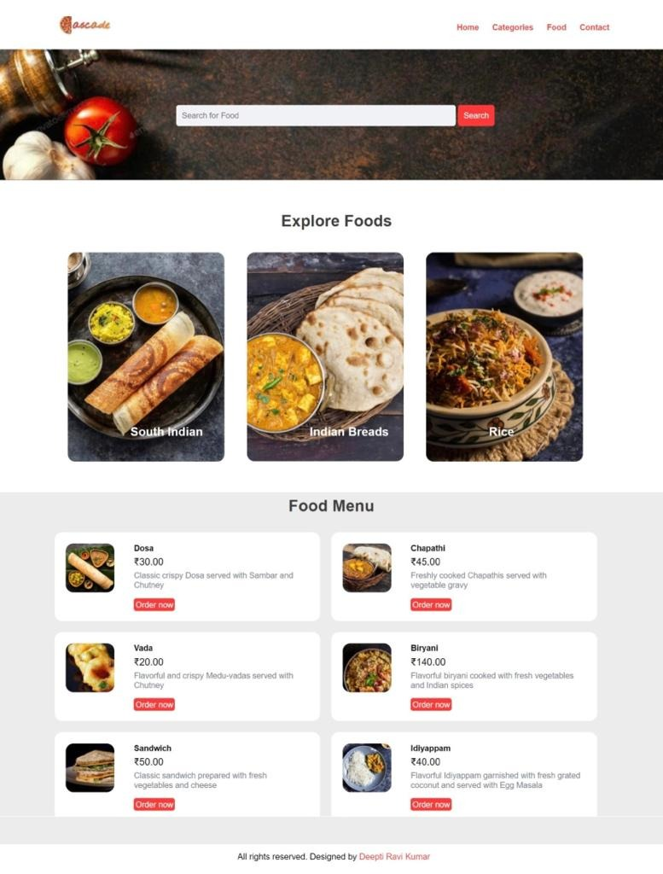
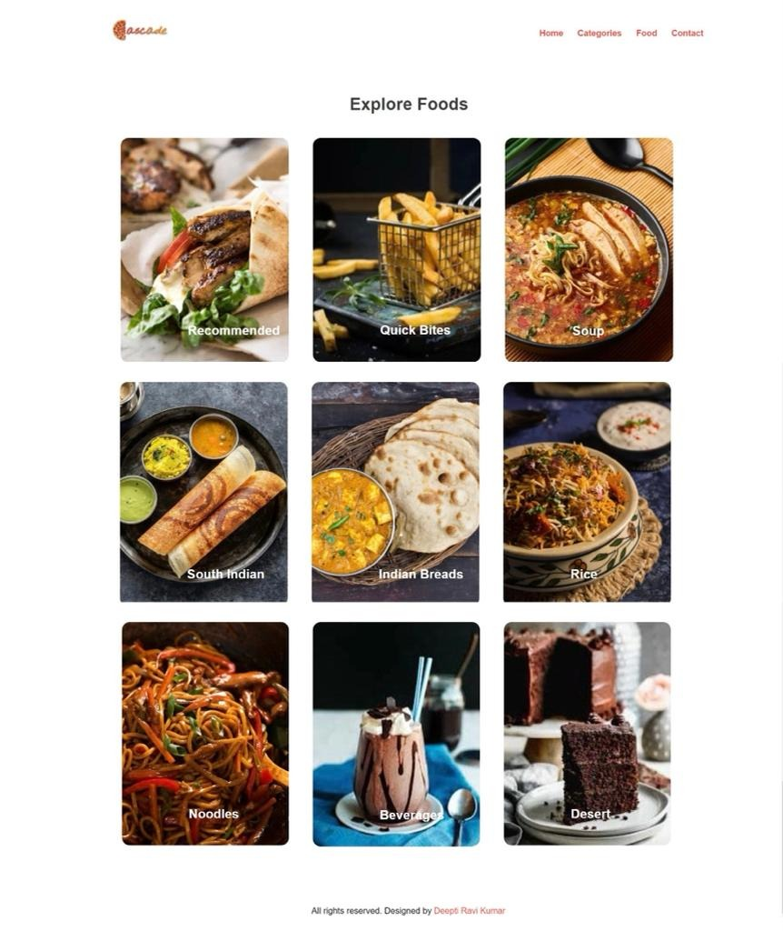
Home page
Categories page

Slide 22
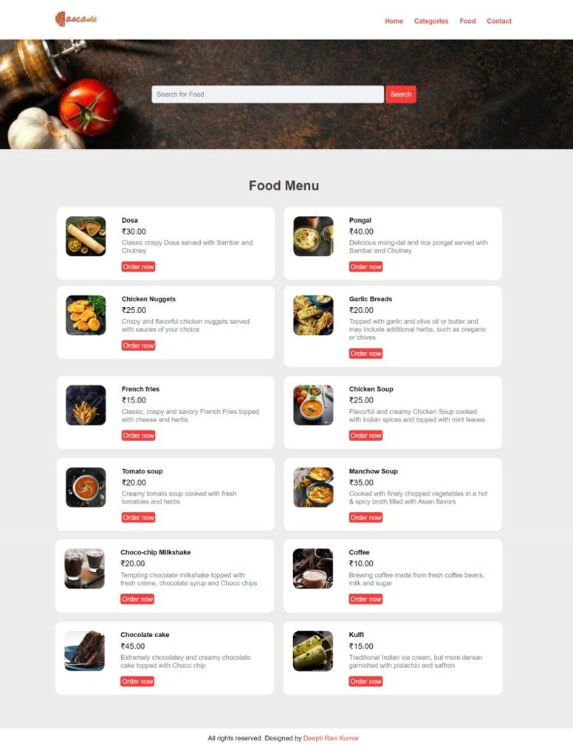
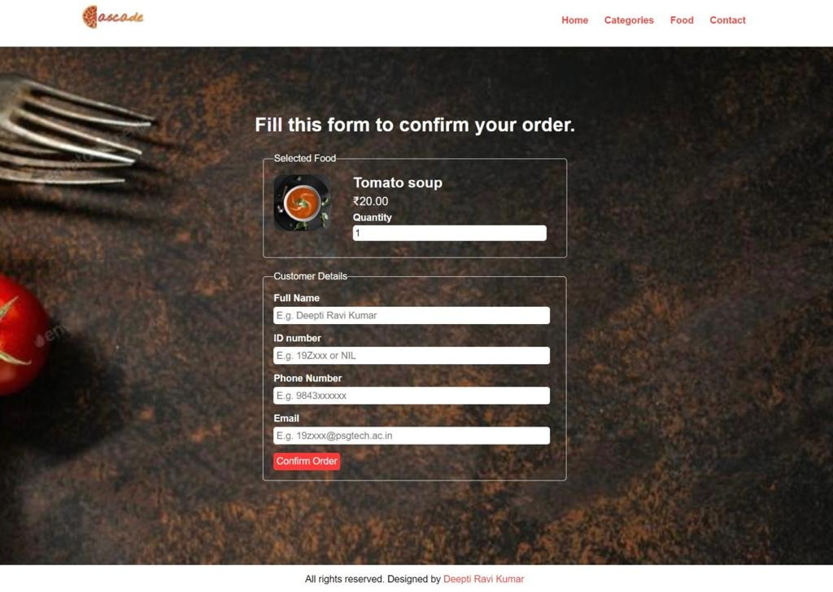
Food menu page
Food order page

Slide 23
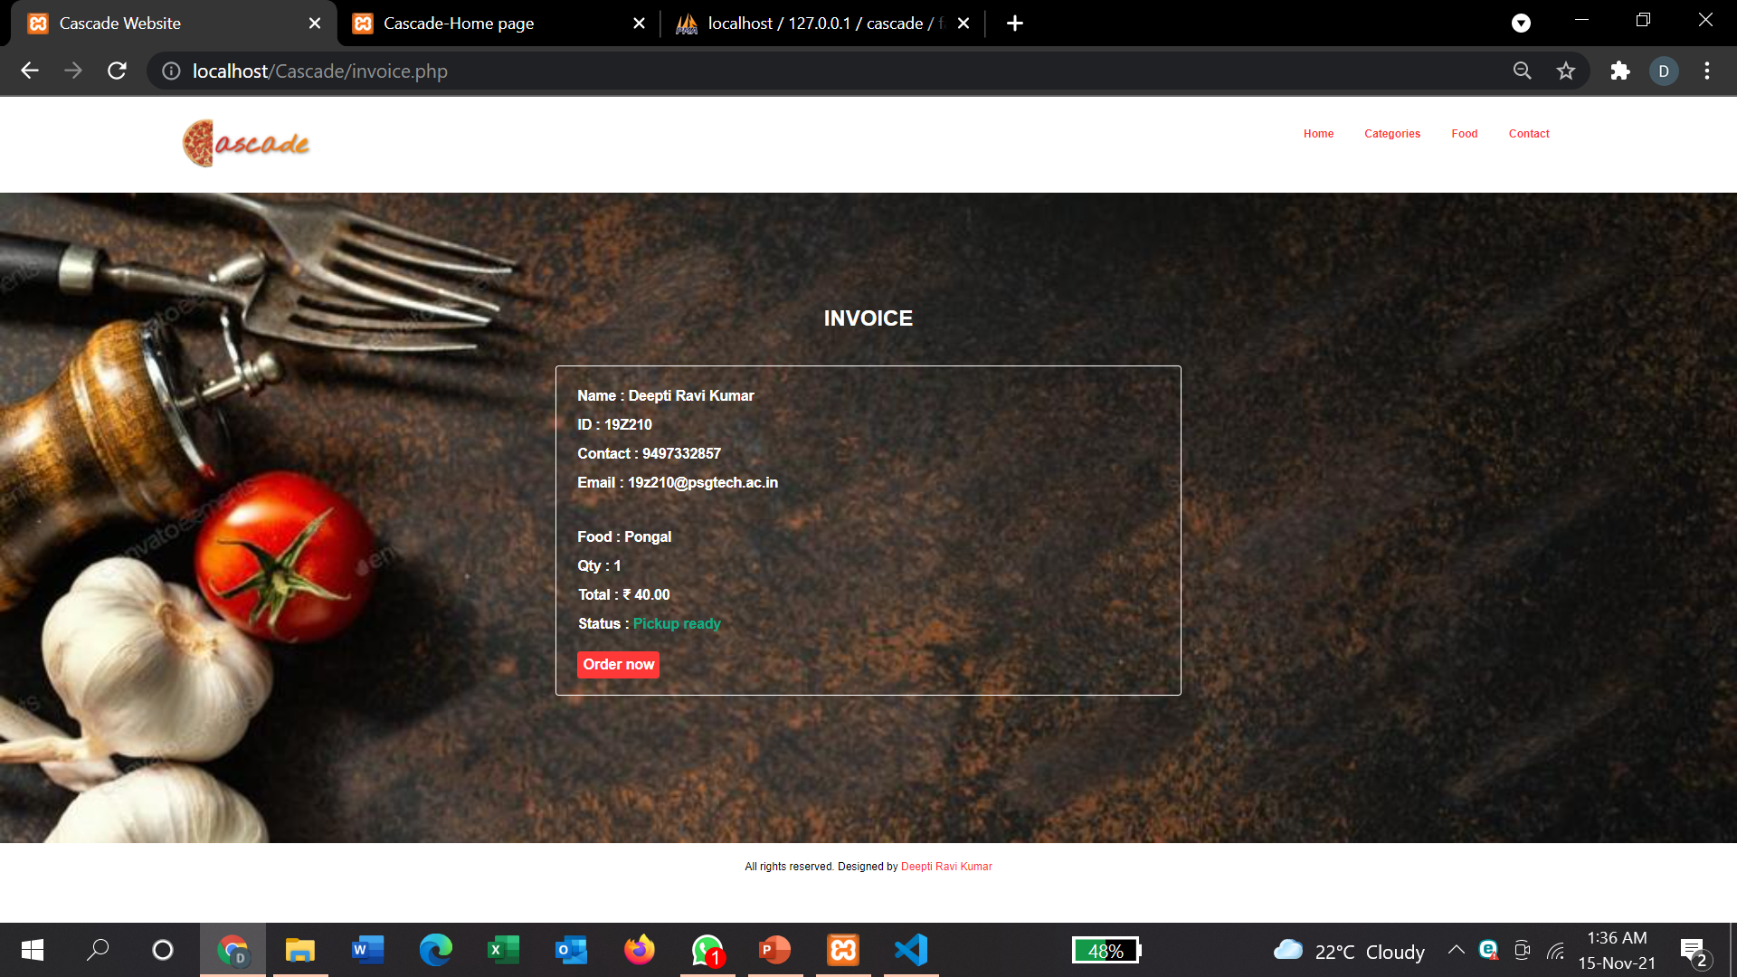
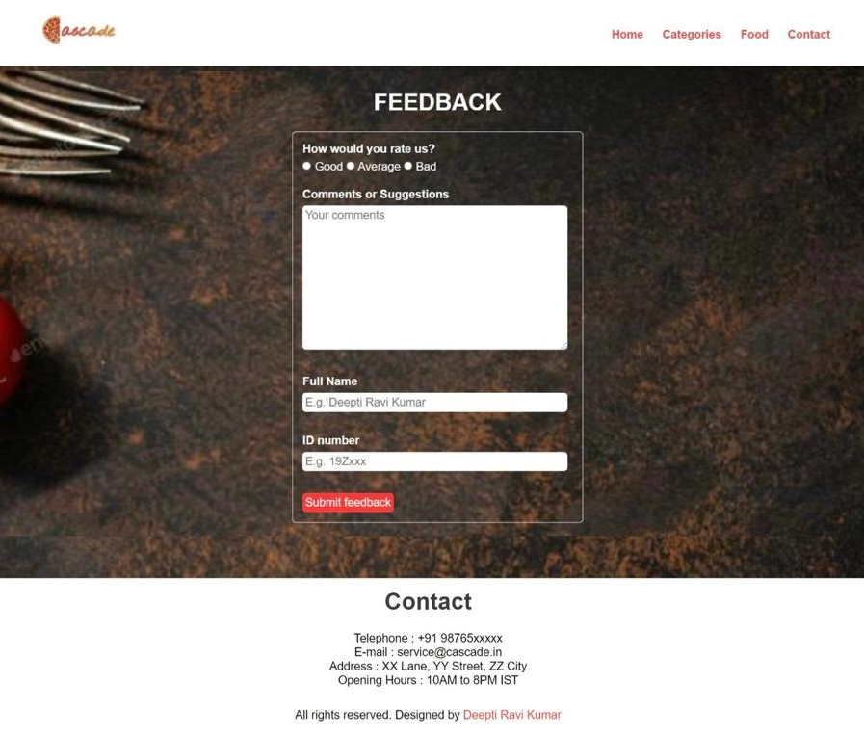
Order invoice
Feedback/Contact page

Slide 24
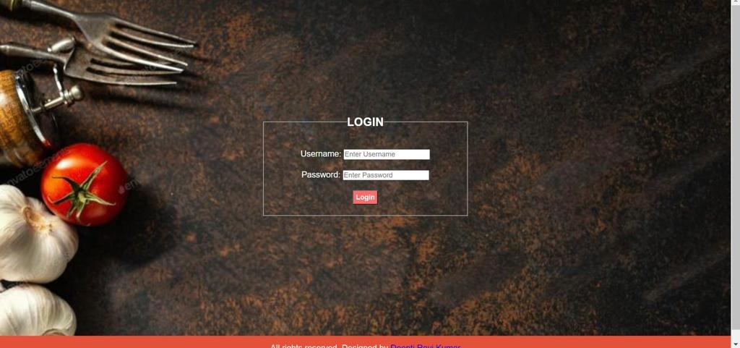
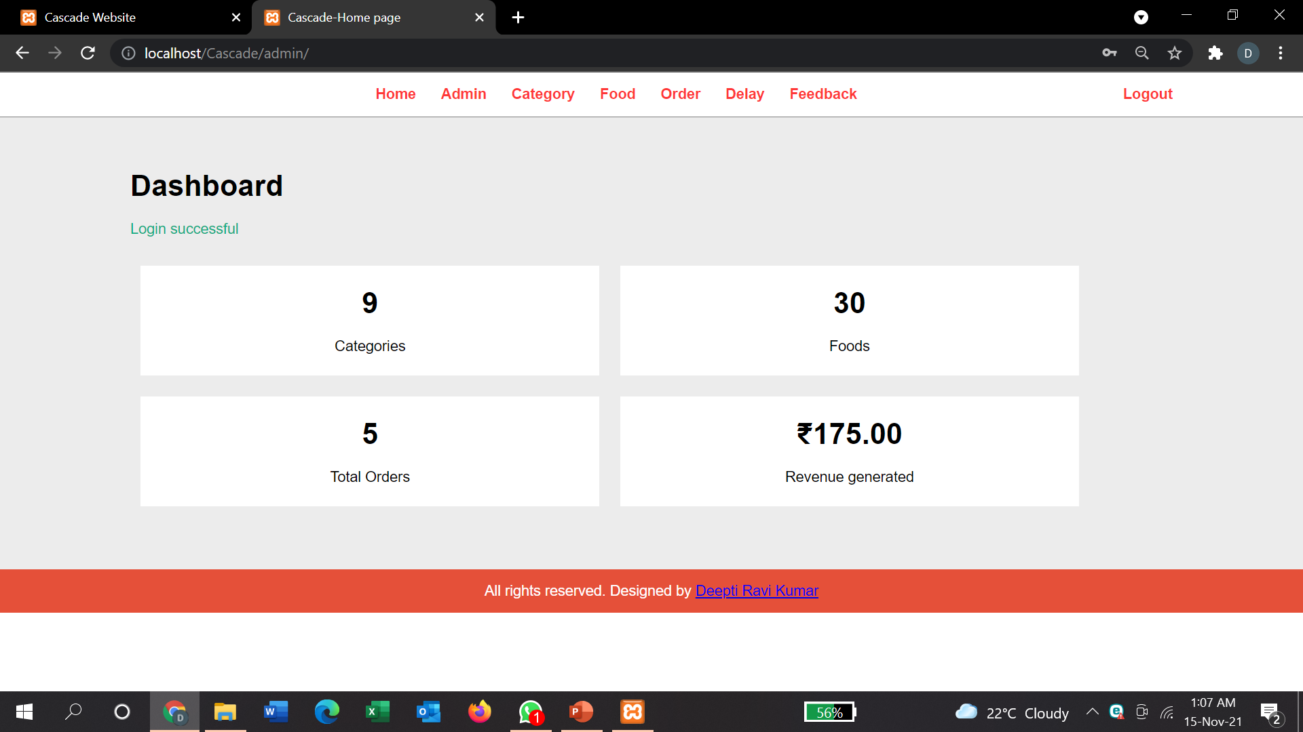
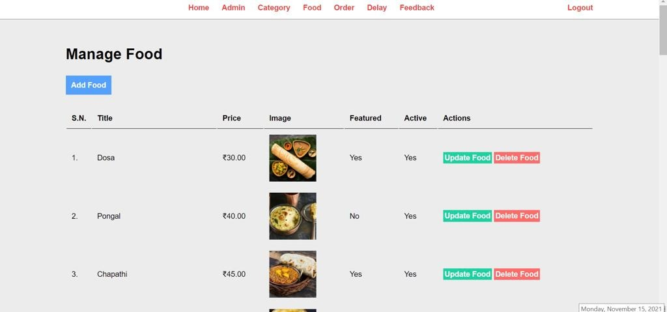
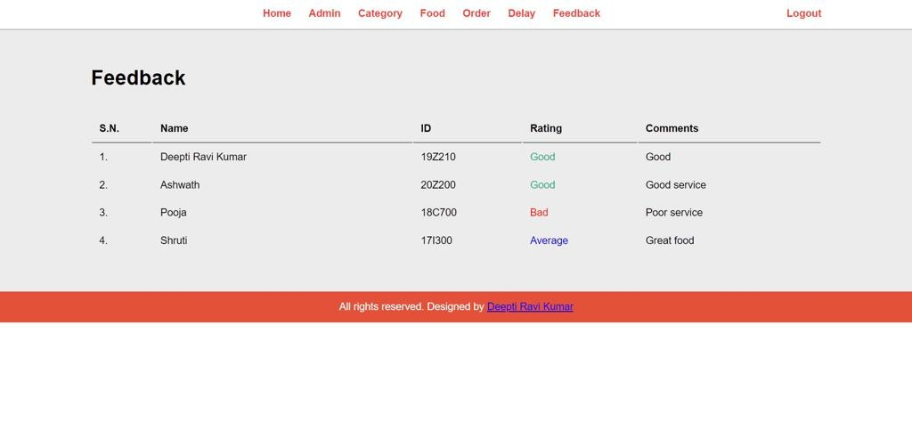
Admin Login
Admin Dashboard
Manage Food page
Feedback page

Slide 25
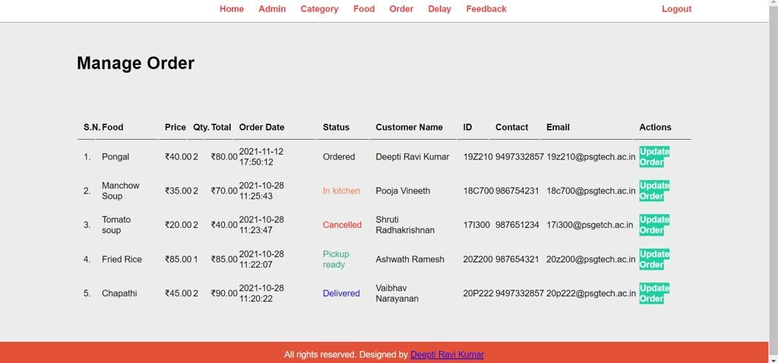
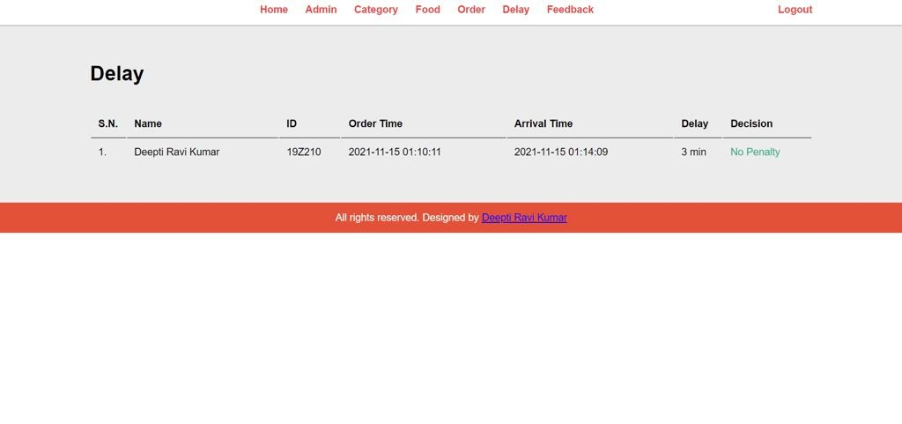
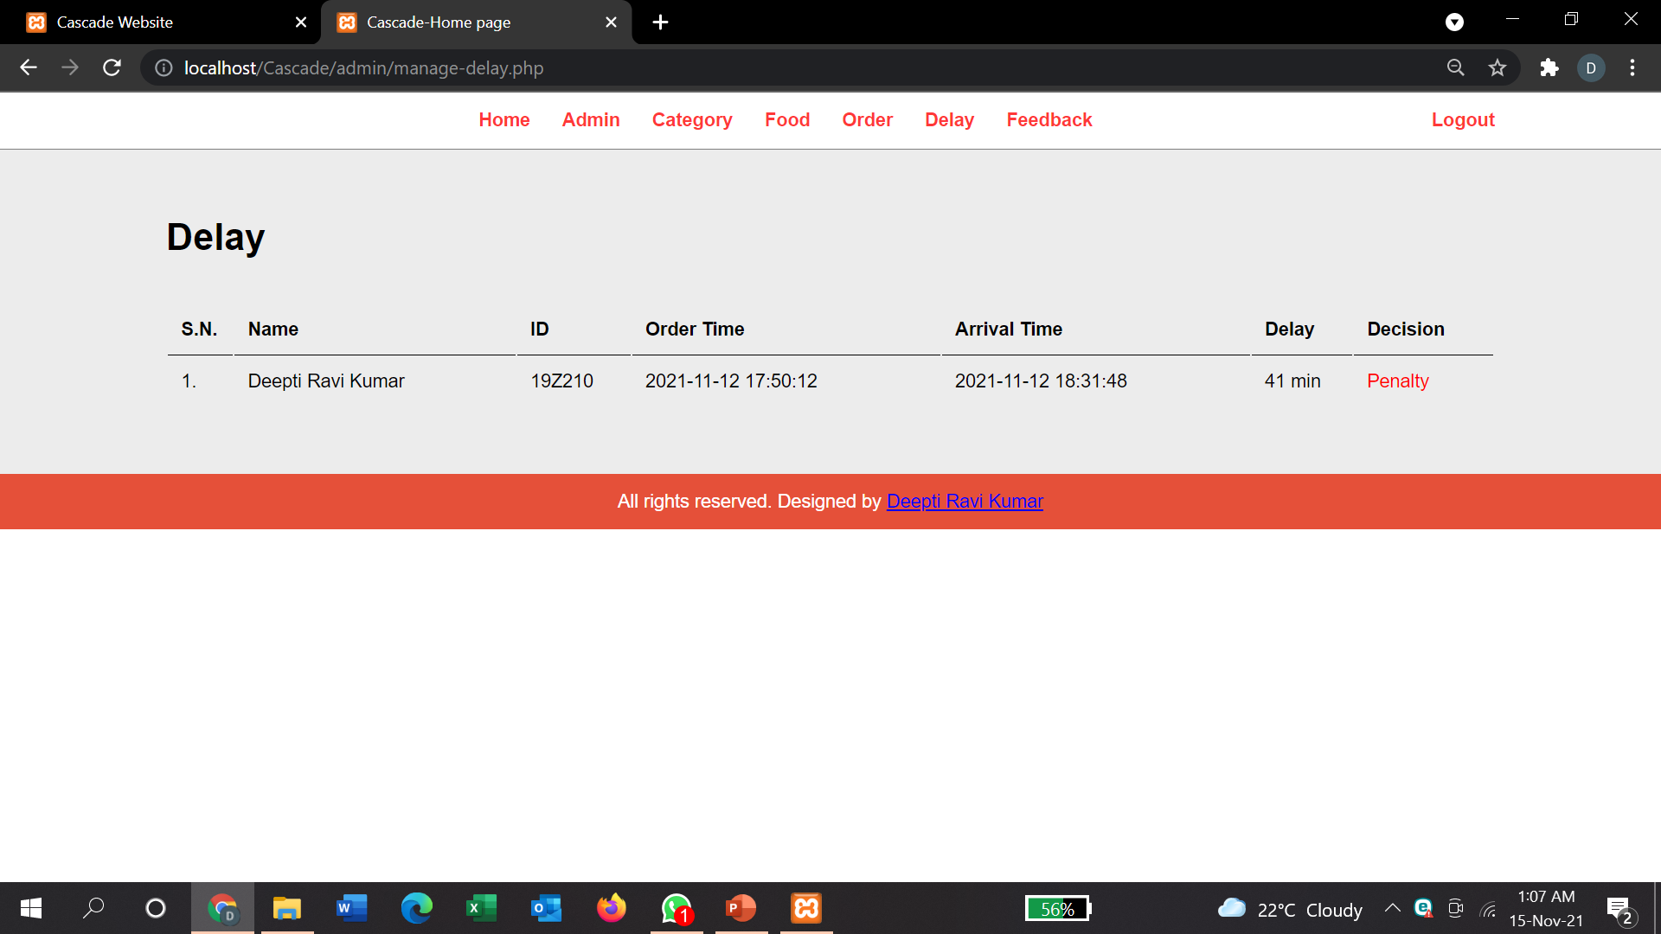
Food orders
Order collection delay and penalty decision

Slide 26
THANK YOU!

